Slide 1
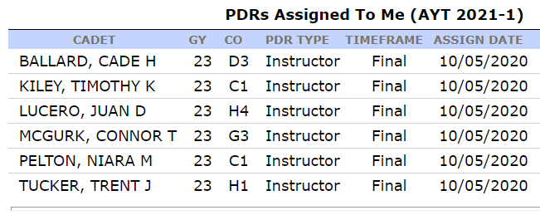
Warning Order
PDRs

Slide 2
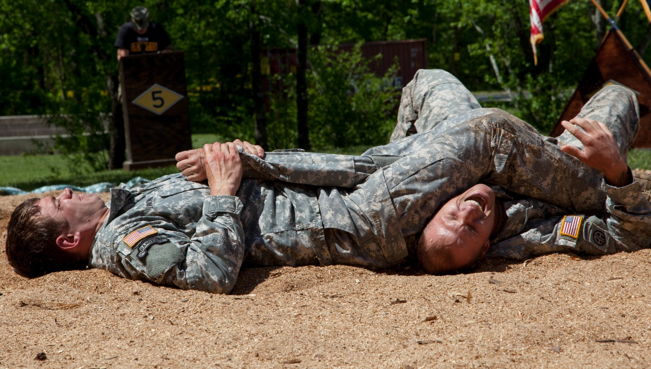
LSN 23
Last Class:
Indirect Fires Planning, by Phase
Today’s Class:
Coordinating Instructions & Timeline Production
Next Class:
Execution Paragraph TDE
You
WPR #3
FC
04 NOV
FC
11 NOV
LSN 22 | LSN 23 | LSN 24 | LSN 25 | LSN 26
Scheme of Maneuver & Fires Graphics, by Phase MS200: OPORD groups assigned to assessing INSTRs | Coordinating Instructions & Timeline Production MS200: OPORD groups assigned to assessing INSTRs | Execution Paragraph TDE CDTs: Groups signup w/assessing INSTRs | Execution Paragraph TDE CDTs: Groups signup w/assessing INSTRs | In-Class: WPR #3 (100 pts) CDTs: Groups signup w/assessing INSTRs
WPR #4
WPR #4

Slide 3
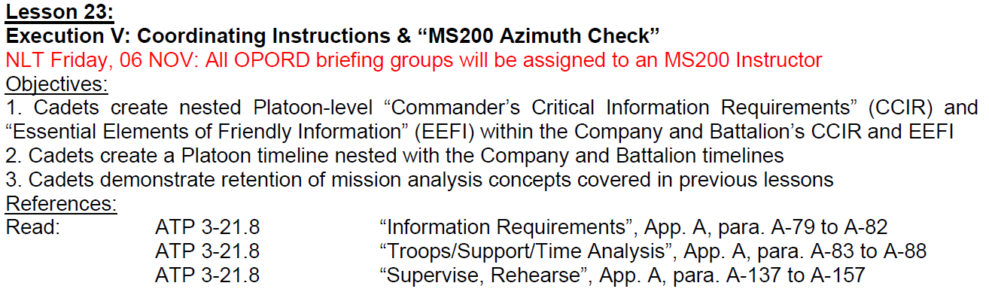
Today’s Target List

Slide 4
OPORD

Slide 5
Historical OPORD Brief Vignette

Slide 6
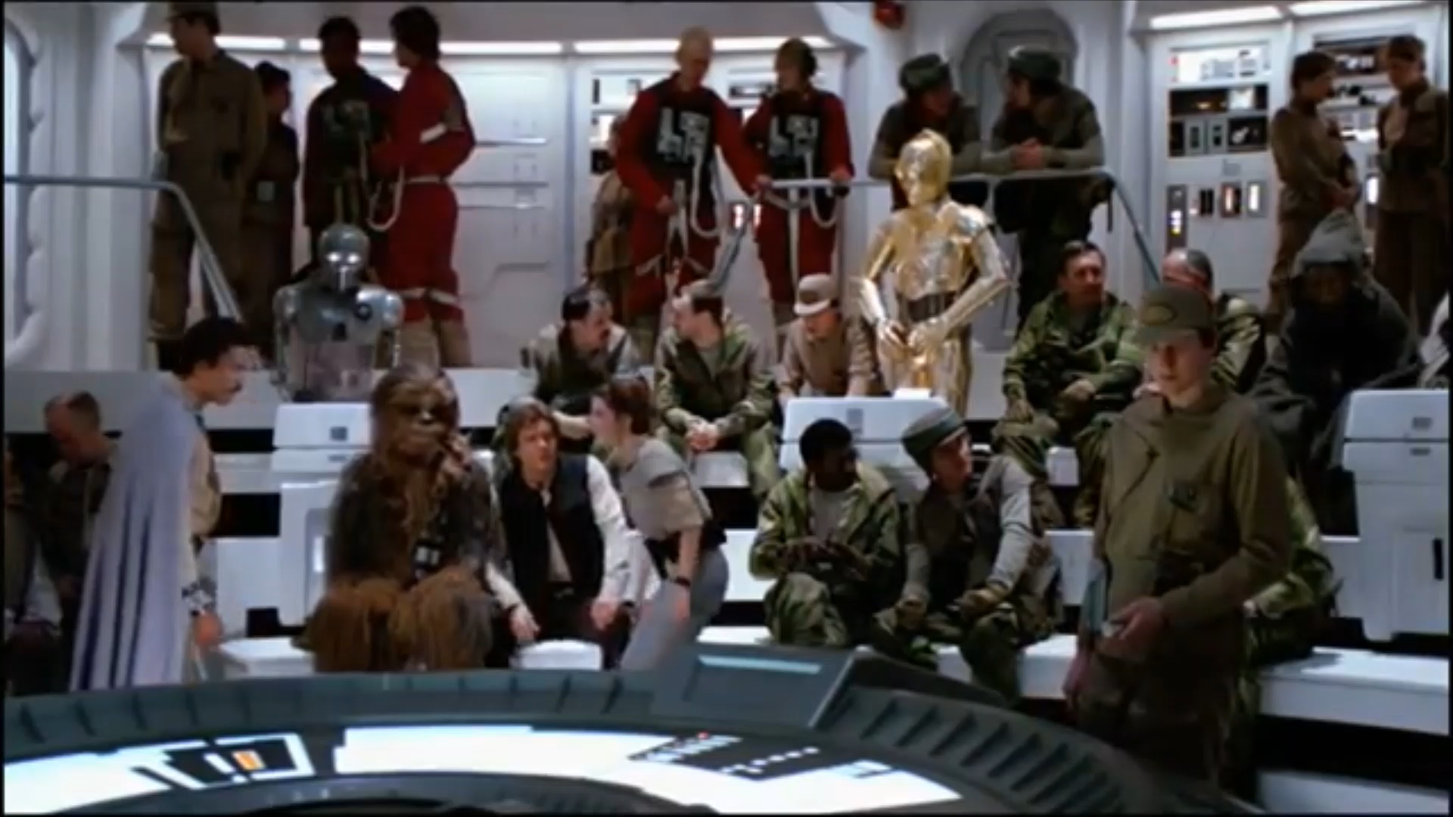

Slide 7


The Battle of Endor
 | Empire | Rebels
Information they know (or need to know) about themselves? | 1 | 2
Information they know (or need to know) about the enemy? | 3 | 4
Information they need to protect from the enemy? | 5 | 6

Slide 8
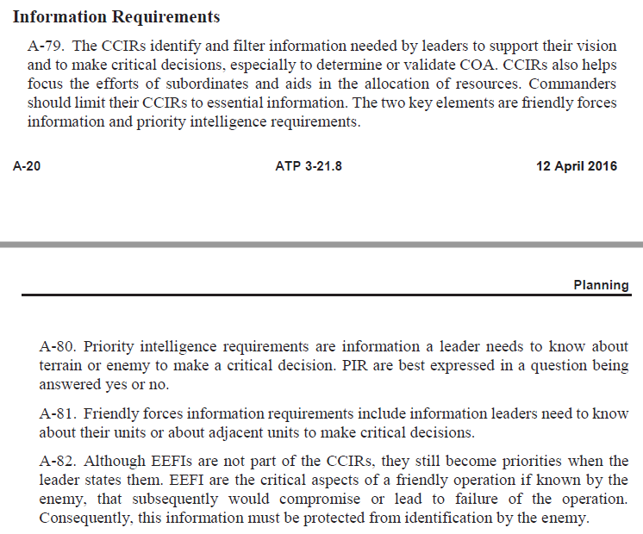
CCIR = FFIR + PIR
K

Slide 9
FFIR
Information we need to know about ourselves that will trigger a decision
When our vehicles fall to 75% operational
Forward Support Company “Amber” status in Fuel or Ammunition
Compromise of friendly element/contact with enemy element prior to initiation of attack
Loss of C2 Element, PLT level and up
Rifle squad rendered ineffective thru loss of three or more personnel
Any fratricide event

Slide 10
PIR
Information we need to know about terrain or enemy that will trigger a decision
"Will the enemy use chemical agents on our reserve force before it leaves AA JEAN-MARIE?“
"Will the enemy defend OBJ KEVIN using a forward-slope defense?"
"Will the enemy reserve tank battalion reach PL FUSS before 270900 MAY 99?"
"Will the 43d Division send its main attack along AA 2?"
"What size force is defending OBJ LEO?"
"Which bridges over the Katie River are intact?“

Slide 11
EEFI
Information about ourselves we must protect from the enemy so that they can’t make decisions
Size of the company
Identification of the DO
Location, schedule, and security arrangements for senior leaders and visiting Very Important Person(s)?
Schedules and movement of troops routes (to include deployments)?
Locations and dispositions of bulk flammables, explosives and ammunition located within the OD area?
Force Protection capabilities or vulnerabilities?
Security measures planned or implemented for high visibility and high personnel concentration events?

Slide 12
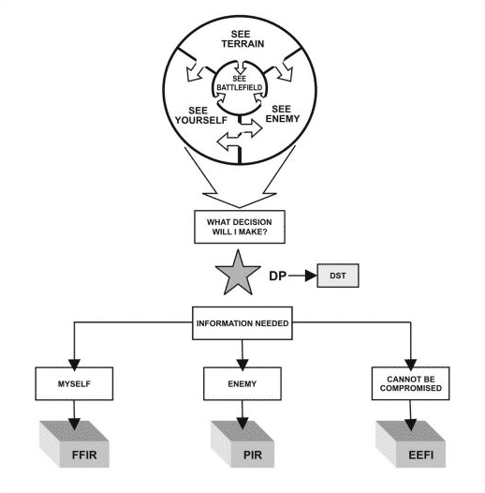

Slide 13
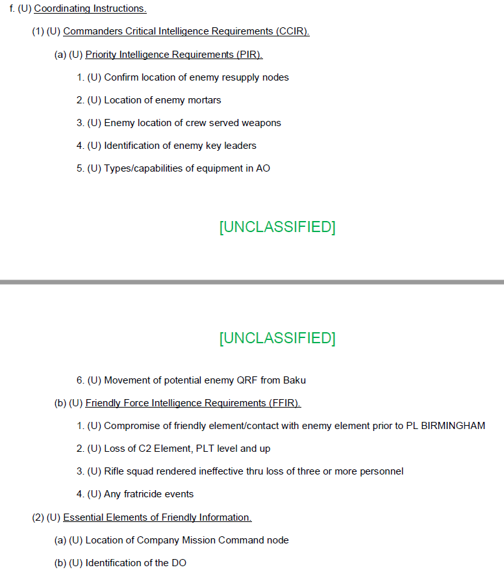
OPN Knight Striker

Slide 14
Coordinating Instructions
CCIR
PIR
FFIR
EEFI
MOPP Level: |  | Other tasks (that apply to two or more units:
PCC & PCI focus:
Rehearsal focus:
Priorities of work:

Slide 15
Operational Timeline
The Operational Timeline is listed in the Coordinating Instructions section of the OPORD. Timelines list all events that affect the unit and its subordinate elements
Subject, time, and location of briefings leaders requires
Times, locations, and forms of rehearsals
Times and locations for Classes of Supply draw
Times of expected enemy actions
Times of potential significant light/weather factors
Operational Timeline and sequence of events.
(ADRP 5-0, ADRP 5-0.1, & ATP 3-21.8)
What events would you include on your OPN Knight Striker OPORD timeline?

Slide 16
Operational Timeline
Operational Time
=
Unusable Time
+Planning Time
+Briefing Time
+Rehearsal Time
+Maneuver Time
+Sustaining Time
+Unforecast Time Constraints
Time Available
-

Slide 17
Supervise/Rehearse
Why Do We Rehearse?
Allow leaders and soldiers to execute key tasks that occur during the concept of the operations.
Allows the platoon leader to ensure subordinates understand their role in the concept of the operations.
Allows the platoon leader to see the plan play out and identify any shortcomings to be identified that may have been omitted from the plan.
What Resources Do We Always Want More Of?
Adequate time is essential when conducting rehearsals. The time required varies with the complexity of the mission, the type and technique of rehearsal, and the level of participation.

Slide 18
Supervise/Rehearse
Maximum
FULL DRESS
KEY LEADER
DIGITAL
Resources
Time Used
Operations & Security Risk
TERRAIN MODEL
OVERLAYS
MAP
Minimum
SKETCH
Minimum
Understanding
Maximum

Slide 19
Platoon Timeline
Time | Event | Location | Who
FREE POINTS FOR WPR #4:
Make it relevant for YOUR PLT!
What are the time hacks…
FOR YOUR PLT?

Slide 20
MS200 Back Azimuth Check

Slide 21
LSN 28
Last Class:
Indirect Fires Planning, by Phase
Today’s Class:
Coordinating Instructions & Timeline Production
Next Class:
Execution Paragraph TDE
You
WPR #3
FC
04 NOV
FC
11 NOV
LSN 22 | LSN 23 | LSN 24 | LSN 25 | LSN 26
Scheme of Maneuver & Fires Graphics, by Phase MS200: OPORD groups assigned to assessing INSTRs | Coordinating Instructions & Timeline Production MS200: OPORD groups assigned to assessing INSTRs | Execution Paragraph TDE CDTs: Groups signup w/assessing INSTRs | Execution Paragraph TDE CDTs: Groups signup w/assessing INSTRs | In-Class: WPR #3 (100 pts) CDTs: Groups signup w/assessing INSTRs
WPR #4
WPR #4

